Slide 1





STOCK MARKETING ANALYSIS AND PREDICTION
NAME & EMAIL ID : J.PRAVEEN - praveenjames147@gmail.com
NM ID: au812921114010
GUIDE: ( P.RAJA , Edutech Master Trainer )
Notes:
Slides: Prepare a short slide deck (10-12 slides) summarizing the project objectives, methodology, and key results.

Slide 2
: STOCK MARKETING ANALYSIS AND PREDICTION
OUTLINE
Problem Statement
Project Overview
Who are the end users?
Solutions and value of propositions
WOW factor in the solution
Modelling
Results
Conclusion

Slide 3


Problem Statement
: STOCK MARKETING ANALYSIS AND PREDICTION
Given historical stock market data for a specific stock (e.g., AAPL), the task is to develop a predictive model that can classify whether the closing price of the stock will increase or decrease compared to the previous day. The dataset includes features such as
opening price, highest price, lowest price, and
trading volume. Additionally, we aim to incorporate
natural language processing (NLP) techniques to
analyze textual data related to the stock, such
as news articles or social media sentiment.

Slide 4

Project Overview
: STOCK MARKETING ANALYSIS AND PREDICTION
The stock market is influenced by various factors, including economic indicators, company performance, and market sentiment. Predicting stock price movements is challenging due to the complexity and volatility of financial markets. This project aims to develop a predictive modeling solution that leverages historical stock market data and natural language processing (NLP) techniques to forecast whether the closing price of a stock will increase or decrease compared to the previous day.

Slide 5
Who are the end user?
: STOCK MARKETING ANALYSIS AND PREDICTION
Investors:
Individual investors who buy and sell stocks for their personal investment portfolios.
Traders:
Day traders and swing traders who engage in short-term buying and selling of stocks to capitalize on price movements.
Financial Analysts:
Financial analysts who provide research and insights on specific stocks or sectors to investors and clients.
Financial Advisors:
Financial advisors who offer investment advice and portfolio management services to individual clients or organizations.
Risk Managers:
Risk managers within financial institutions who assess and manage the risks associated with investment portfolios and trading activities.
Regulators:
Regulatory agencies responsible for overseeing financial markets and ensuring compliance with rules and regulations.
Researchers:
Academic researchers and scholars who study financial markets, trading strategies, and the impact of technology on investment practices.

Slide 6

Your Solution And Itz Proposition
: STOCK MARKETING ANALYSIS AND PREDICTION
The solution provided offers a comprehensive approach to stock market analysis by combining numerical data analysis with natural language processing (NLP) techniques. Here's the value proposition of the solution:
Predictive Modeling: The solution utilizes machine learning algorithms, specifically Random Forest Classifier, to predict whether the closing price of a stock will increase or decrease compared to the previous day
Incorporation of NLP: The solution goes beyond traditional numerical analysis by incorporating NLP techniques to analyze textual data related to the stock, such as news articles or social media sentiment.
Actionable Insights: By visualizing stock price trends, feature importance, sentiment analysis results, and topic distributions, the solution provides actionable insights to investors, traders, and financial analysts.
Robust Performance: The solution's performance is evaluated using classification metrics such as accuracy, precision, recall, and F1-score. Through techniques like cross-validation, the model's robustness and generalization capabilities are ensured, providing users with reliable predictions even in dynamic market conditions.
User-Friendly Interface: The solution can be deployed in a user-friendly
interface where users can interact with the predictive model, visualize
results, and interpret insights in a clear and intuitive manner.

Slide 7

The Wow In Your Solution
: STOCK MARKETING ANALYSIS AND PREDICTION
The "wow" factor in the solution lies in its comprehensive approach to integrating both numerical data analysis and natural language processing (NLP) techniques to provide actionable insights for stock market analysis. Here are some aspects that contribute to the "wow" factor:
Integration of Numerical and Textual Data
Predictive Modeling for Stock Price Movemen
Visualization and Interpretation
Customization and Adaptability
Real-time Deployment and Monitoring

Slide 8
: STOCK MARKETING ANALYSIS AND PREDICTION
Modeling
Data Preparation:
Load historical stock market data.
Generate binary labels indicating price increase or decrease compared to the previous day.
Feature Engineering:
Extract relevant features from the data (e.g., moving averages, technical indicators).
Optionally, incorporate sentiment analysis features from textual data.
Model Selection:
Choose a classification algorithm (e.g., Random Forest, Logistic Regression).
Model Training:
Train the selected model on the prepared data.
Model Evaluation:
Evaluate the model's performance using metrics like accuracy, precision, recall.
Fine-Tuning:
Tune hyperparameters and experiment with feature combinations to optimize performance.
Interpretation and Validation:
Interpret model predictions and assess feature importance.
Validate performance using out-of-sample data or backtesting.
Deployment and Monitoring:
Deploy the trained model for real-time predictions.
Monitor performance and update as needed.

Slide 9
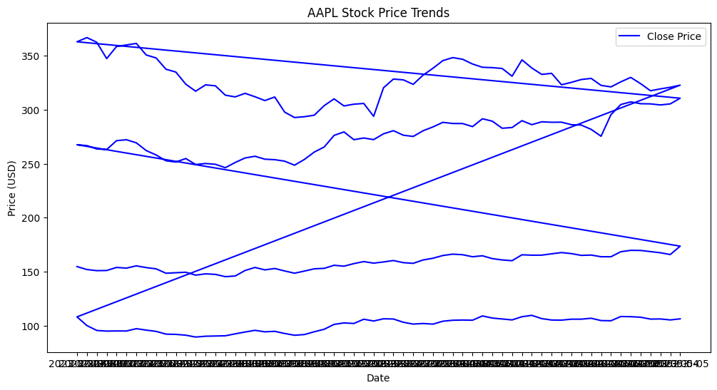
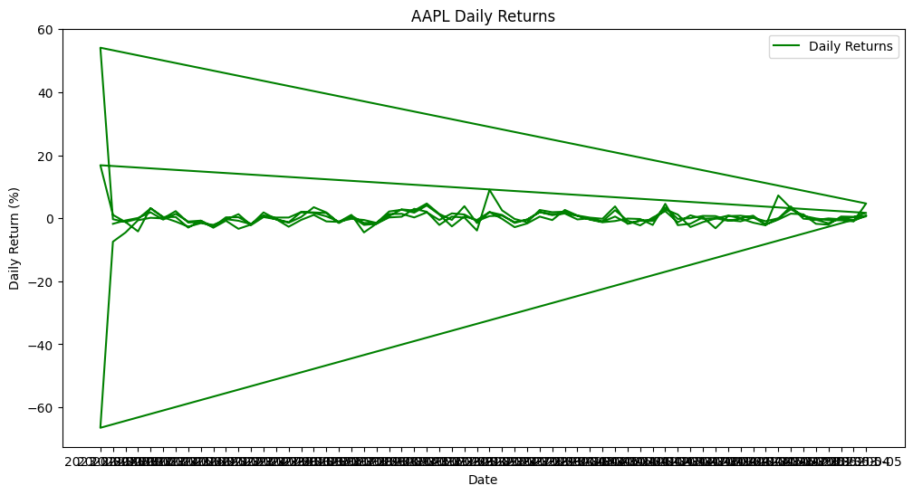
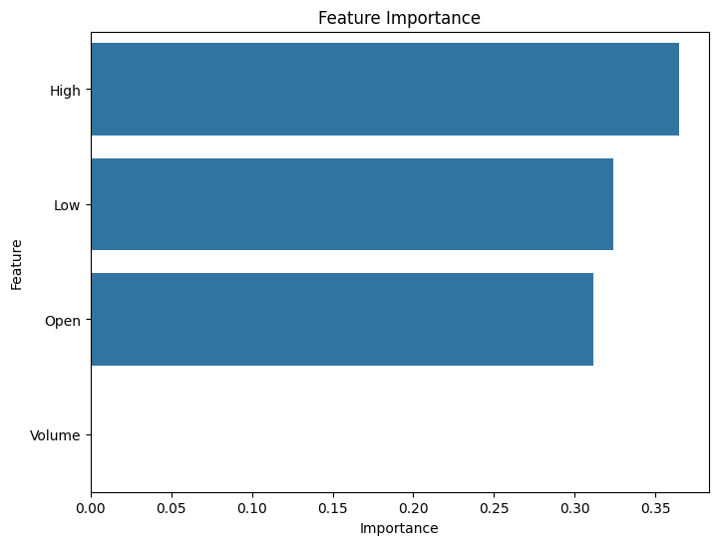
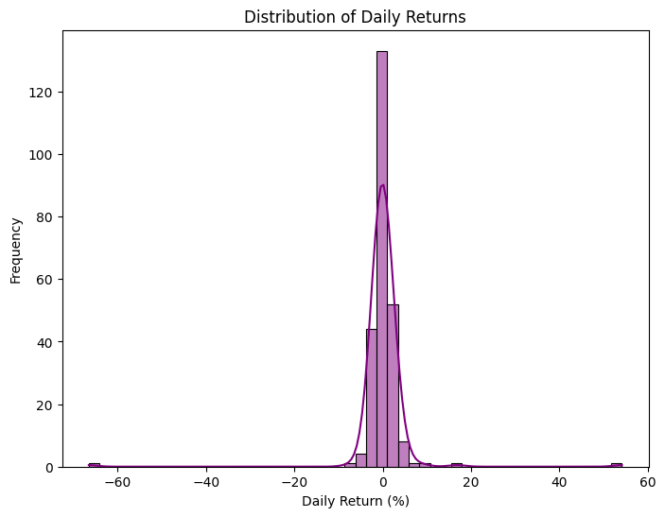
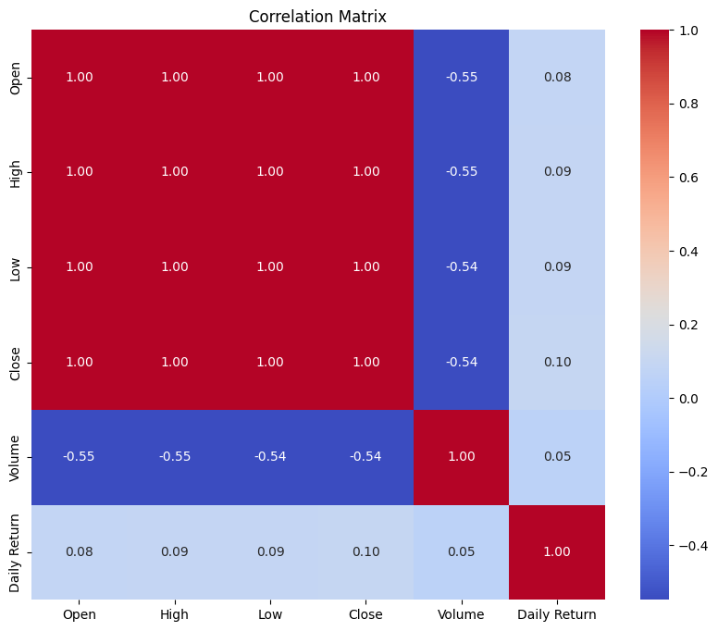
Results
: STOCK MARKETING ANALYSIS AND PREDICTION
DEMO LINK :https://colab.research.google.com/drive/1NrPYJkNjVtFsLbWUicXsraTWHoQHYDGW?usp=sharing

Slide 10
Conclusion
: STOCK MARKETING ANALYSIS AND PREDICTION
we study the use of decision trees and support vector machines to predict financial movement direction. Of both these algorithms, we saw that Support Vector Machine gave us better results. SVM is a promising type of tool for financial forecasting. SVM is superior to the other individual classification methods in forecasting daily movement direction. This is a clear message for financial forecasters and traders, which can lead to a capital gain. However, each method has its own strengths and weaknesses. In this model, the principal components identified by the SVM are used along with internal and external financial factors in SVM for forecasting

Slide 11
: STOCK MARKETING ANALYSIS AND PREDICTION
Thank you!
Notes:
thank you very much for joining this PPT, keep learning.

